Slide 1

Blue prism - day 2
Excel exercises
Blue Prism Korea
May, 10, 2022

Slide 2

Excel Automation
교육 내용
Excel Application의 구성
Excel Automation Exercise
Notes:
HIDDEN SLIDE – SECTION TOO LONG FOR THE WORKSHOP - PLEASE SPEAK THE ONE MOST IMPORTANT POINT
The rapid proliferation of IoT devices will require Service providers to :
deal with the huge amount of data provided by these devices
deploy, maintain and manage the high number of IoT devices
With IoT increased data and information-sharing, Blue Prism’s automation and AI can spot trends and patterns predicting various outcomes
Relevance to you
Through working with Blue Prism we can mitigate risk and improve efficiency within IoT environments, whilst allowing customers to focus on activities that drive profitability and prominence for you Business.

Slide 3
Excel Application의 구성
Excel Instance, Workbooks and Worksheets
Excel Instance
Workbook
Workbook
Worksheet
Worksheet

Slide 4
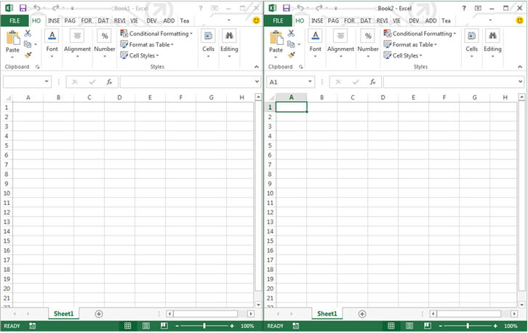
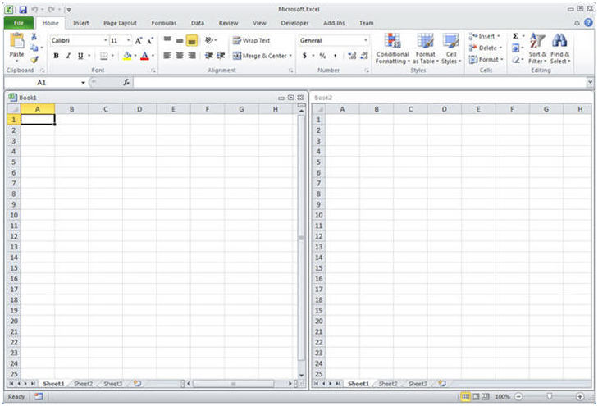
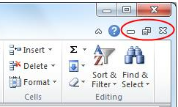
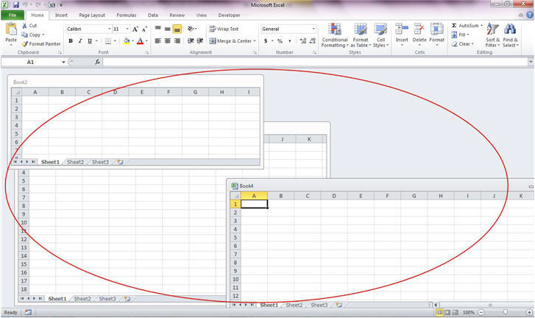
Excel Application의 구성
과거의 엑셀 스타일 and 현재의 엑셀 스타일
Figure 1. Single Document Interface in Excel 2013
Figure 2. Multiple Document Interface in Excel 2010

Slide 5
실습#1
Function for MS Excel VBO – Extended
C:\Program Files\Blue Prism Limited\Blue Prism Automate\VBO
Exercise
Collection으로 데이터 읽어 오기
Excel Workbook & Worksheet 생성
Excel 에 Collection 데이터 쓰기
Collection Append 하기
Collection 중복 행 제거
Notes:
HIDDEN SLIDE – SECTION TOO LONG FOR THE WORKSHOP - PLEASE SPEAK THE ONE MOST IMPORTANT POINT
The rapid proliferation of IoT devices will require Service providers to :
deal with the huge amount of data provided by these devices
deploy, maintain and manage the high number of IoT devices
With IoT increased data and information-sharing, Blue Prism’s automation and AI can spot trends and patterns predicting various outcomes
Relevance to you
Through working with Blue Prism we can mitigate risk and improve efficiency within IoT environments, whilst allowing customers to focus on activities that drive profitability and prominence for you Business.

Slide 7
실습#2
Scenario
Excel Exercise 아래 있는 구별 주유소 데이터들을 Collection으로 읽기.
“세차장 여부“ 컬럼을 생성하여 세차장이 있는 주유소에는 “Y” 없는 주유소에는 “N”을 표시. (세차장이 있는 주유소 리스트는 파일명 끝에 (Y)가 붙은 파일을 참고)
새로운 워크북을 생성하여 구별로 시트를 생성.
앞서 만든 “세차장 여부＂컬럼을 포함한 Collection들을 해당하는 구 이름의 시트에 작성.
최종 결과 파일을 임의의 경로에 저장.
앞서 작성한 오브젝트에 필요한 모든 기능이 있음.
Remove Duplicate Rows by Column Action은 첨부한 bprelease 파일을 import 하여 사용.
Notes:
HIDDEN SLIDE – SECTION TOO LONG FOR THE WORKSHOP - PLEASE SPEAK THE ONE MOST IMPORTANT POINT
The rapid proliferation of IoT devices will require Service providers to :
deal with the huge amount of data provided by these devices
deploy, maintain and manage the high number of IoT devices
With IoT increased data and information-sharing, Blue Prism’s automation and AI can spot trends and patterns predicting various outcomes
Relevance to you
Through working with Blue Prism we can mitigate risk and improve efficiency within IoT environments, whilst allowing customers to focus on activities that drive profitability and prominence for you Business.

